Slide 1

^{MAKERERE} ^{UNIVERSITY}
COLLEGE OF COMPUTING AND INFORMATION SCIENCES
SCHOOL OF COMPUTING AND INFORMATION TECHNOLOGY
COURSE UNIT: DATA ANALYTICS AND VISUALISATION
COURSE CODE: MCS 7227
COURSE LECTURER: DR ROSE NAKASI
STUDENT NAME: NAKIBUUKA SANYU SOLOMY
REGISTRATION NUMBER: 2023/HD05/18798U
STUDENT NUMBER: 2300718798

Slide 2
Video Recording Link
https://youtu.be/2jcPXSa3S1g

Slide 3
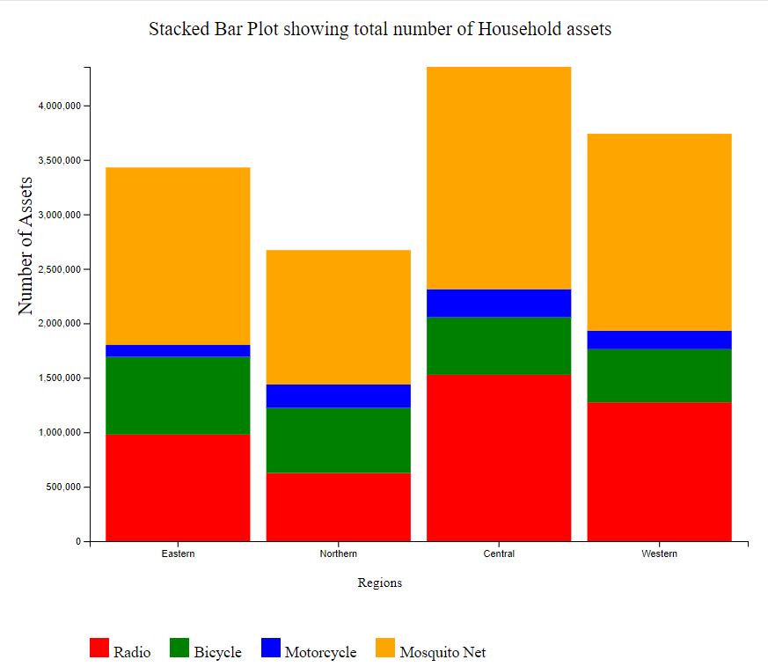

Slide 4
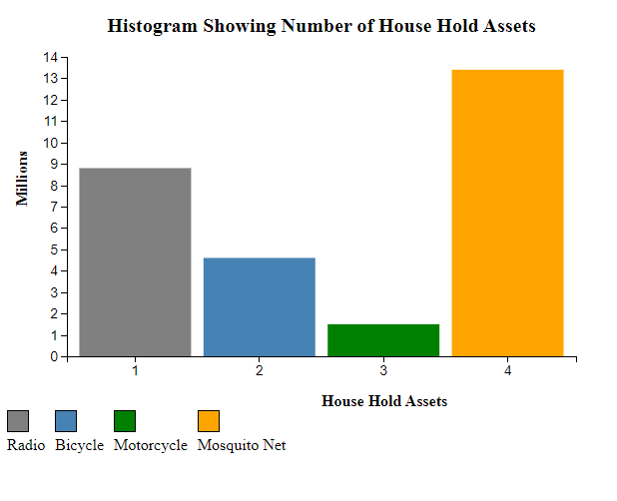

Slide 5
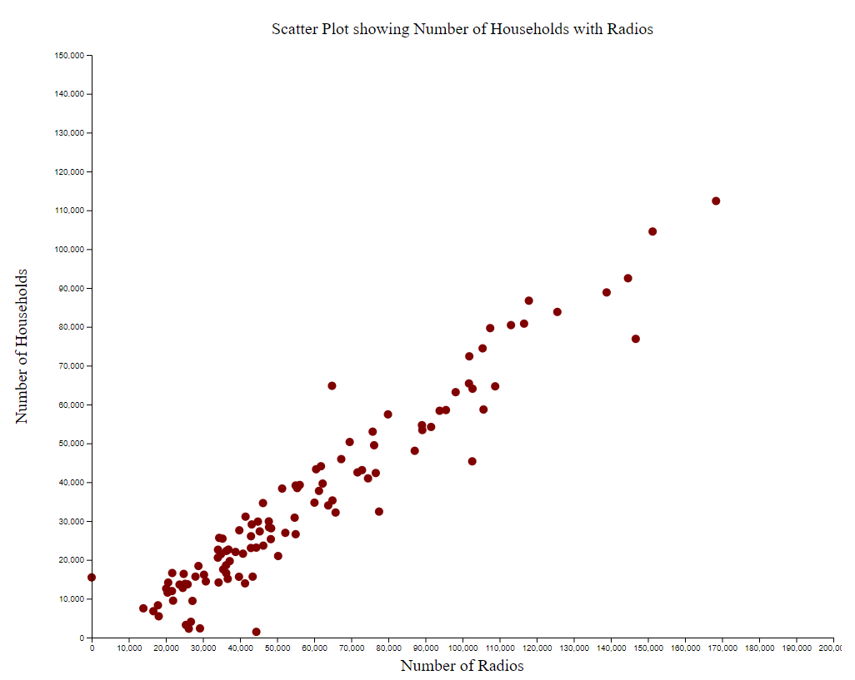

Slide 6
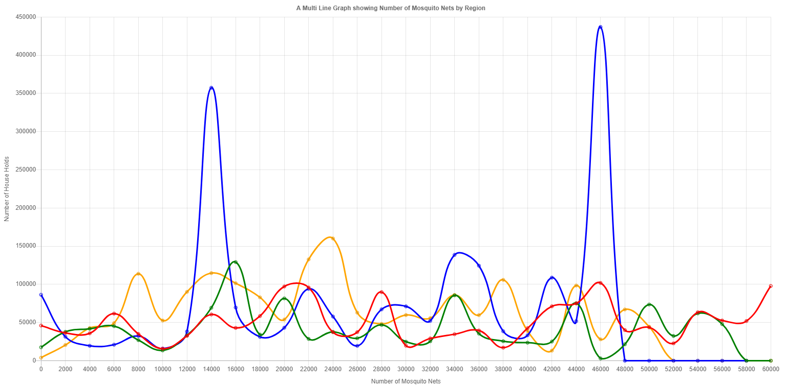

Slide 7
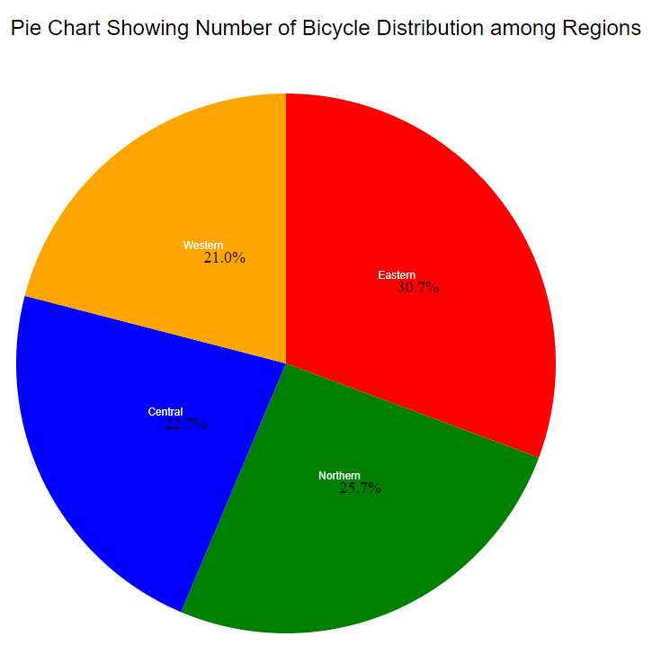

Slide 8
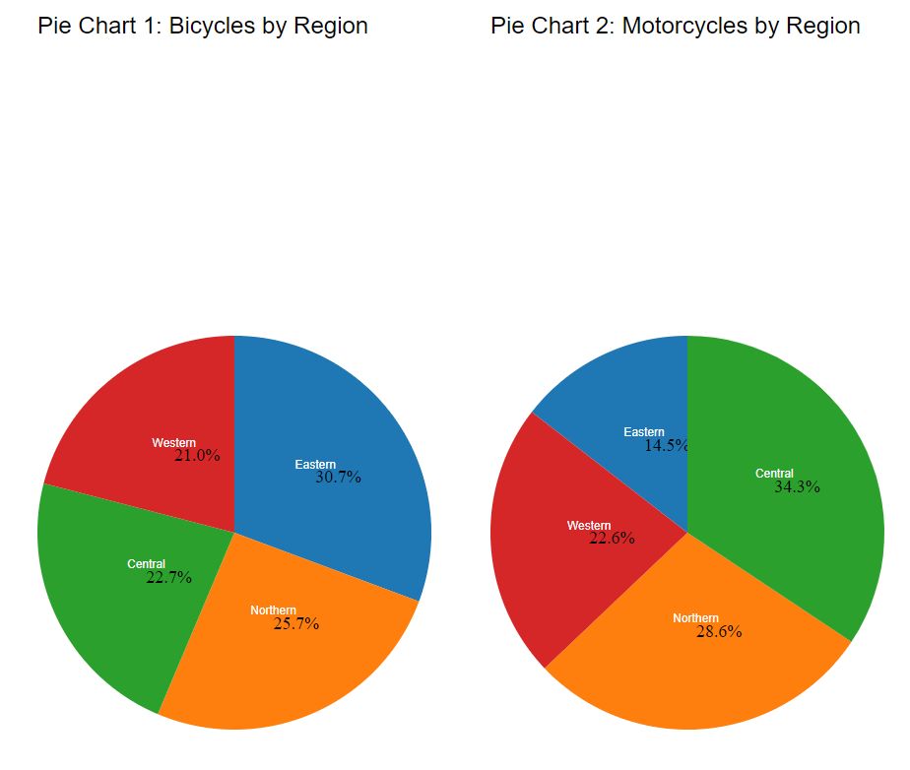

Slide 9
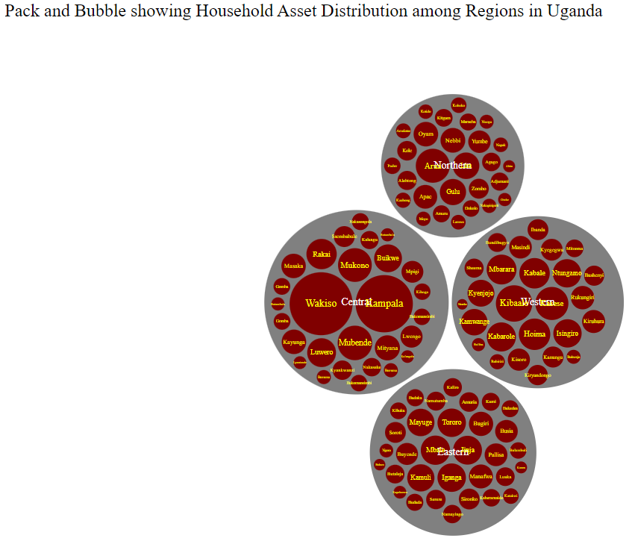

Slide 10
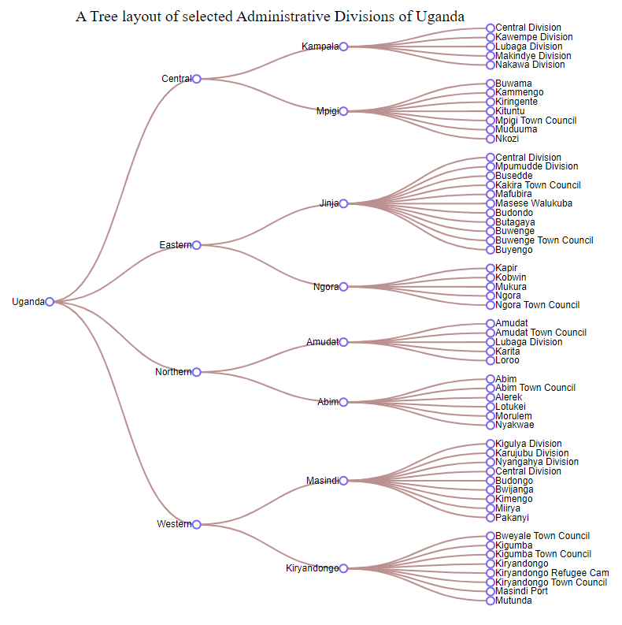

Slide 11
END

